Slide 1
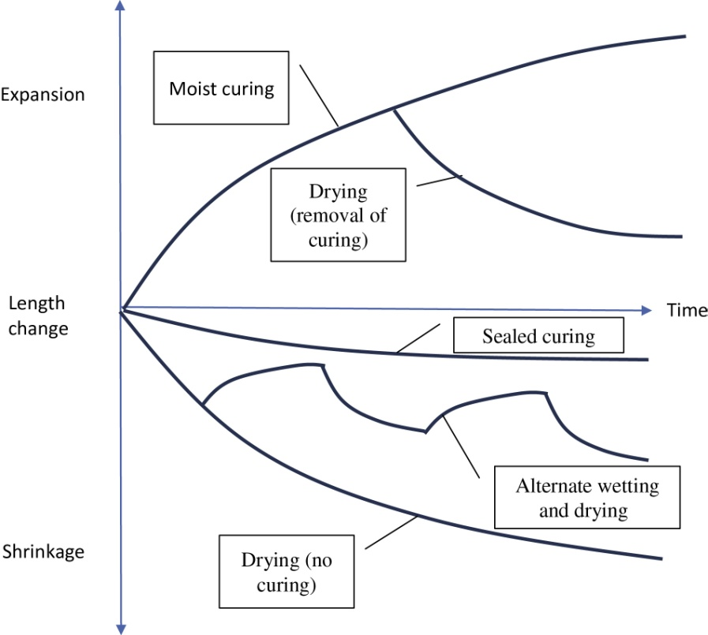
FIGURE 23.1 The Effect of Different Wetting and Drying Cycles
Copyright © 2016 Elsevier Ltd. All rights reserved.

Slide 2
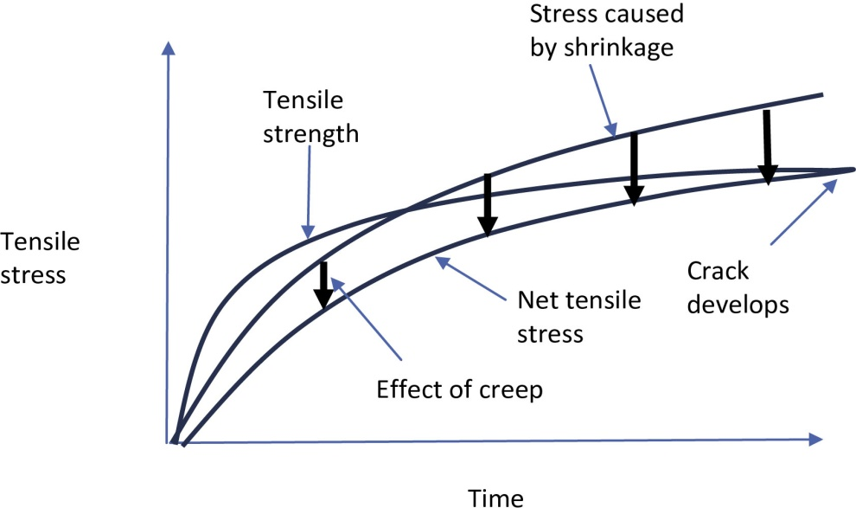
FIGURE 23.2 The Effect of Creep Relieving Shrinkage Stresses
Copyright © 2016 Elsevier Ltd. All rights reserved.

Slide 3
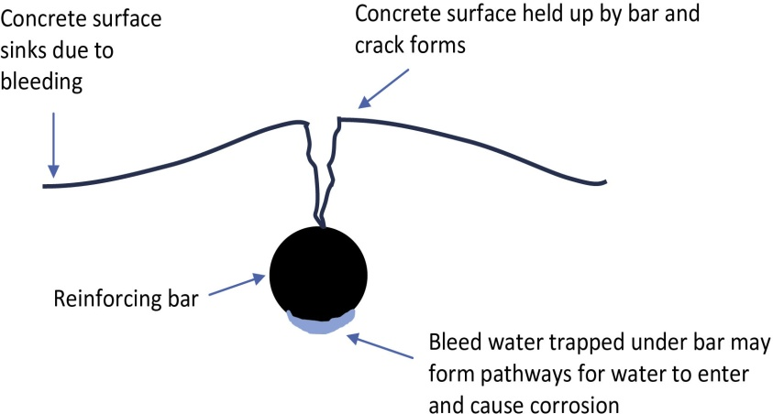
FIGURE 23.3 Plastic Settlement Over a Reinforcing Bar
Copyright © 2016 Elsevier Ltd. All rights reserved.

Slide 4
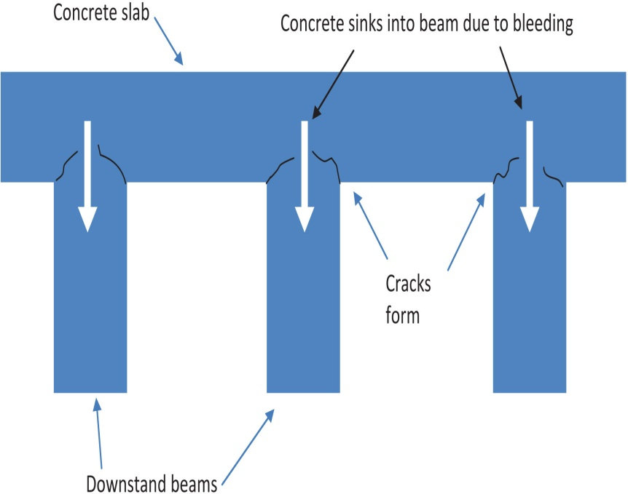
FIGURE 23.4 Plastic Settlement Cracking in Beam and Slab Construction
Copyright © 2016 Elsevier Ltd. All rights reserved.

Slide 5
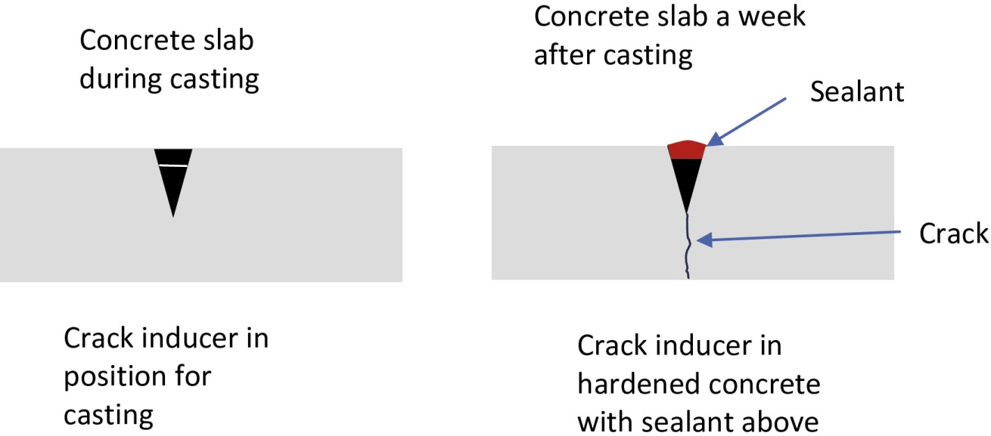
FIGURE 23.5 Crack Inducer in Concrete
Copyright © 2016 Elsevier Ltd. All rights reserved.

Slide 6
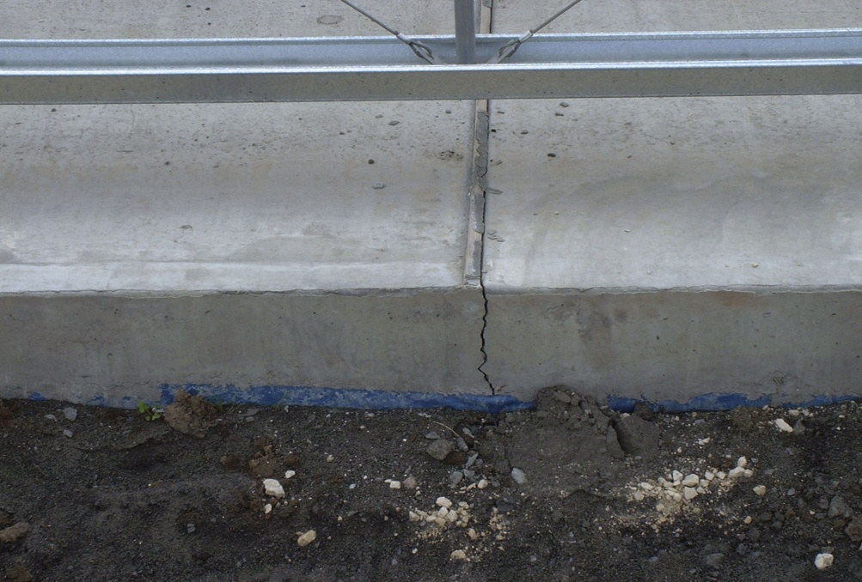
FIGURE 23.6 Crack Caused by Crack Inducer
Copyright © 2016 Elsevier Ltd. All rights reserved.

Slide 7
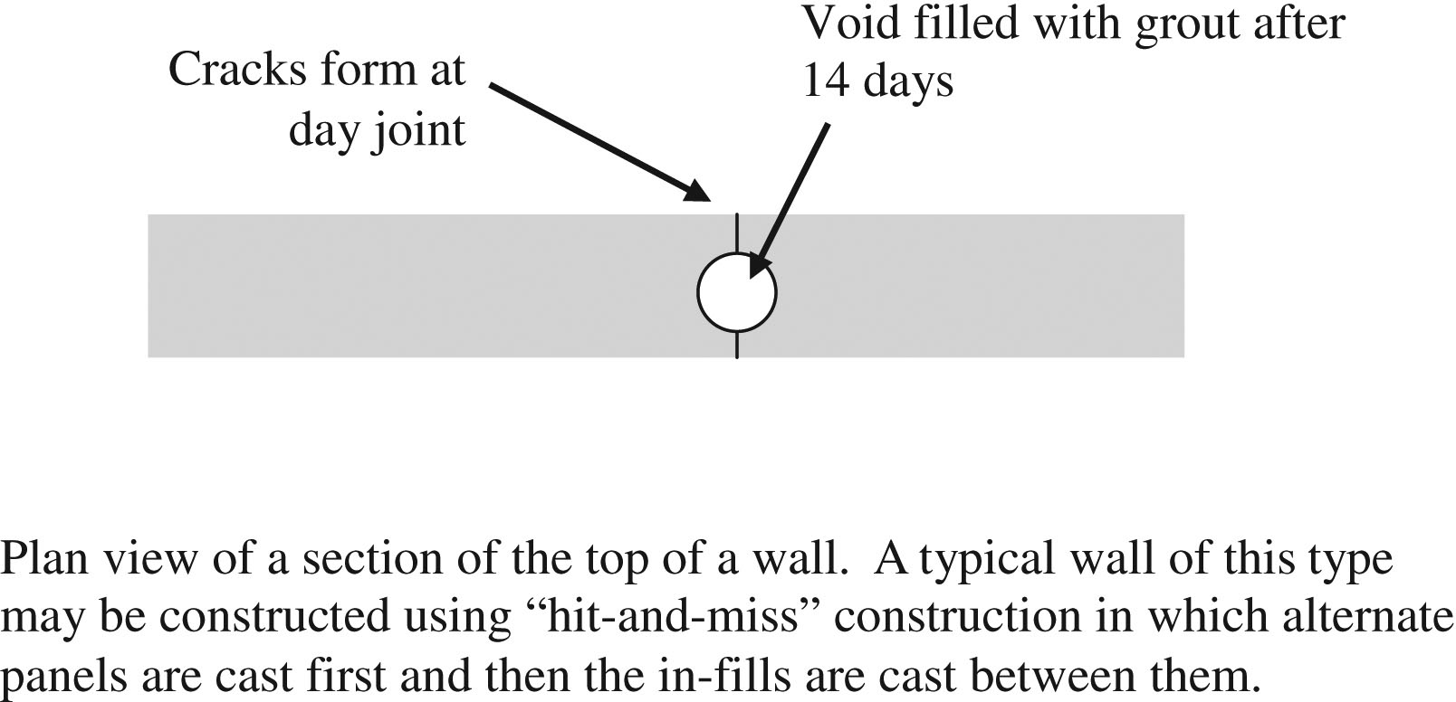
FIGURE 23.7 Detail Used to Fill Cracks
Copyright © 2016 Elsevier Ltd. All rights reserved.

